Slide 1
NeuroImaging Analysis at Scale
Erin Dickie, erin.w.dickie@gmail.com
Helpers: Jerry Jeyachandra, Michael Joseph, Olivia Stanley, Jason Kai
Part of https://tinyurl.com/toss2019
Etherpad: https://pad.carpentries.org/scinet-neuroimaging

Slide 2
The Plan
A (re?) introduction to MR nomenclature - with BIDS
“Converting” to BIDS
What are BIDS apps?
Queueing up neuroimaging pipelines with help from gnu-parallel and qbatch

Slide 3

Let’s check out some public neuroimaging data
https://openneuro.org/

Slide 4
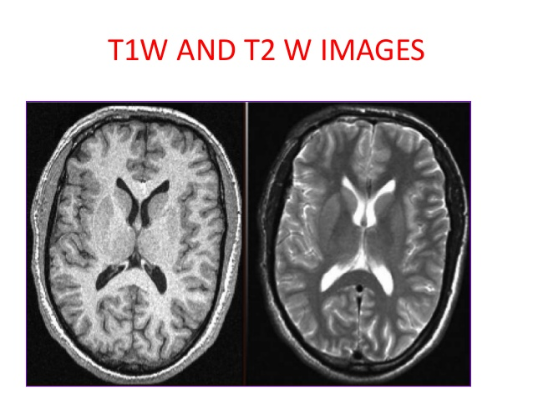
“Anat” data
Anat ---> Anatomnical
3-dimensional image of anatomy
note at 3D “pixel” is a “voxel”
T1w is the most common
in a _T1w.nii.gz
White matter is white
Gray matter is gray
Cerebral spinal fluid (CSF) is black

Slide 5
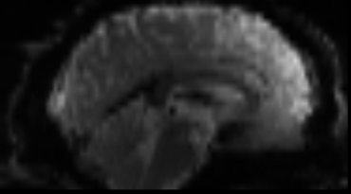
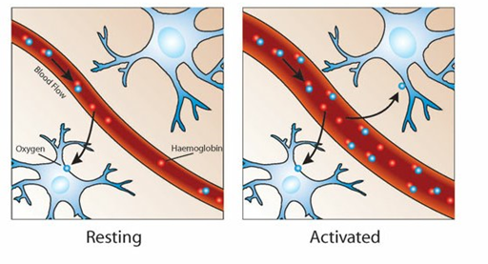
“Func” data
Func → functional MRI
Track the Blood Oxygen Level Dependant (BOLD) signal
Has the suffix _bold.nii.gz
It’s 4-dimensional
X,y,z + time!
they usually need an _event.tsv file
if there is no events --> "it's task-rest"
sometimes there's matching physio data
Image from :https://www.win.ox.ac.uk//fmrib-about/what-is-fmri
Notes:
source:https://www.win.ox.ac.uk//fmrib-about/what-is-fmri

Slide 6
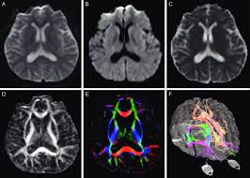
DWI data
Dwi → diffusion weighted imaging
Measures diffusion of water in order to model tissue microstructure
It’s a 4-dimensional image
X,Y,Z + direction of diffusion
We need parameters about the strength of the diffusion “gradient” and it’s direction to process the image
.bval and .bvec files

Slide 7
Sidenote:
Getting data with datalad

Slide 8
Getting data with datalad - preamble
Code: https://github.com/edickie/bids-on-scinet/blob/master/tutorial_code/00_pull_some_data_w_datalad.md
Step 2: convert from docker to singularity - this uses a Docker image put out by singularity can docker2singularity
Note: we are using the "-v" mounts to give it two input paths
/var/run/docker.sock is the place where all your docker images are sitting
/scratch/edickie is the location where I want the output image to end up
ssh <username>@teach.scinet.utoronto.ca
module load git-annex/2.20.1 # we need this for datalad to work
module load anaconda3 # in order for the conda load bit to work
source activate /scinet/course/ss2019/3/5_neuroimaging/conda_envs/datalad

Slide 9
Installing a dataset
Code: https://github.com/edickie/bids-on-scinet/blob/master/tutorial_code/00_pull_some_data_w_datalad.md
This install's the data - which for a dataset means that we get the "small" data (i.e. the text files) and the download instructions for the larger files
We can now navigate the dataset like it's a file system and plan our analysis
datalad install ///openfmri/ds000030

Slide 10
Getting data 1
Code: https://github.com/edickie/bids-on-scinet/blob/master/tutorial_code/00_pull_some_data_w_datalad.md
When we know what we want to run we can use the "get" command to download those files we need Let's get all the imaging files for sub-10171
cd ds000030
datalad get sub-10171/

Slide 11
Getting and dropping data
Code: https://github.com/edickie/bids-on-scinet/blob/master/tutorial_code/00_pull_some_data_w_datalad.md
We can also use linux patterns here - i.e. lets get only the T1w images from the first few subjects
When we are done our analysis. We can "drop" the data (i.e. delete the big files, but keep a record of where they came from) Note: the drop command will only run when datalad knows that another copy of that file exists somewhere (i.e. the server you download from).
Another note: in the first version we use the datalad "datasets" shortcut (/// these are download links that the datalad developers have curated) But anyone can build a datalad repo, and these can be published to anywhere repo's are housed.
# get anat files for 4 subjects
datalad get sub-101*/anat/*T1w.nii.gz
# delete anat files - while holding onto metadata
datalad drop sub-1015*/anat/*T1w.nii.gz

Slide 12
Datalad install from github
Code: https://github.com/edickie/bids-on-scinet/blob/master/tutorial_code/00_pull_some_data_w_datalad.md
But anyone can build a datalad repo, and these can be published to anywhere git repo's are housed.
OpenNeuro Curates some of it's own repo's they are at: https://github.com/OpenNeuroDatasets
Let's get another dataset using this.
datalad install https://github.com/OpenNeuroDatasets/ds000003.git

Slide 13

http://bids.neuroimaging.io/

Slide 14
Why “Convert” the community to BIDS?
So we can share data
a common file structure for both computers and humans can understand
Using file formats/conventions that are most common in the neuroimaging community (i.e. NIFTI)
show completeness of the data right away
So we can build/run better pipelines
All the information you need to design a pipeline for a particular dataset is machine readable
Pipelines can be more complex (under the hood) with fewer command-line arguments

Slide 15
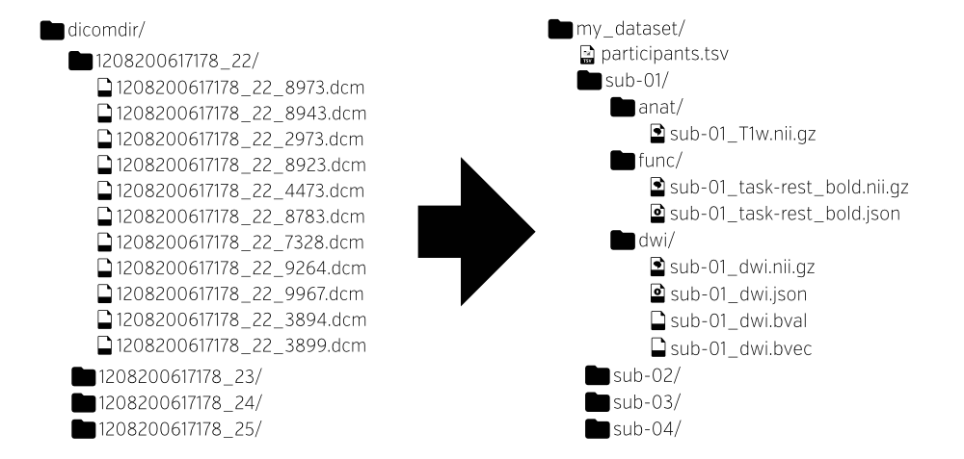
Folder Structure
What’s in BIDS?

Slide 16
Naming convention
sub-{id}
sess-{id}
task-{id}
run-{id}
What’s in BIDS?

Slide 17
.tsv files for tabular data
.json files for key-value pairs
What’s in BIDS?

Slide 18
http://bids.neuroimaging.io/ (examples)

Slide 19
BIDS - y - fying your dataset - Method 1
Example 1: no programing required - no excuses
use dcm2niix to convert from DICOM
and then rename as needed
Let’s go through the tutorial:
https://github.com/bids-standard/bids-starter-kit/blob/master/README.md
http://reproducibility.stanford.edu/bids-tutorial-series-part-1a/#man1

Slide 20
BIDS validator
Useful for:
Check if the data is in BIDS
Get warning about missing data
Used internally by pipelines
https://github.com/INCF/bids-validator (code)
https://bids-standard.github.io/bids-validator/ (online tool)

Slide 21
BIDS - y - fying your dataset - Method 2
Code: https://github.com/edickie/bids-on-scinet/blob/master/tutorial_code/zz_bids-y-fy_example2.md
Example 2: Add hoc minimal programming
When you just need the pipeline to run…
- rename files into the BIDS convention
- "hand write" some .json files until the validator passes
- add participants.tsv
- add a README.md
- add a dataset_description.json
- this is where the "inheritance principle" is your friend
Let’s go through an example - note that the code is here:
https://github.com/edickie/bids-on-scinet/blob/master/tutorial_code/zz_bids-y-fy_example2.md

Slide 22
Example - the case of Rea Search
Code: https://github.com/edickie/bids-on-scinet/blob/master/tutorial_code/zz_bids-y-fy_example2.md
Hey Rea,
Great to see you at the conference last month. Here's the data we talked about for that
new project. We tested 5 participant 4 months apart with diffusion, resting-state and our new favorite task.
The data is organized according to modality. I attached a spreadsheet of the participant demographics for you.
Looking forward to seeing how this project works out!
Cole Labo
https://drive.google.com/file/d/1W34FKyjMm_lV_f5yejlrWg98jzqivqZF/view?usp=sharing

Slide 23
BIDS - y - fying your dataset - Method 3 - plus
There are a tone of open tools out there to help convert to BIDS!
Do not reinvent the wheel if you don’t have to!
Some popular one’s are:
heudiconv
XNAT to BIDS
Check out the BIDS starter kit for links to advanced tutorials!
http://reproducibility.stanford.edu/bids-tutorial-series-part-2a/

Slide 24
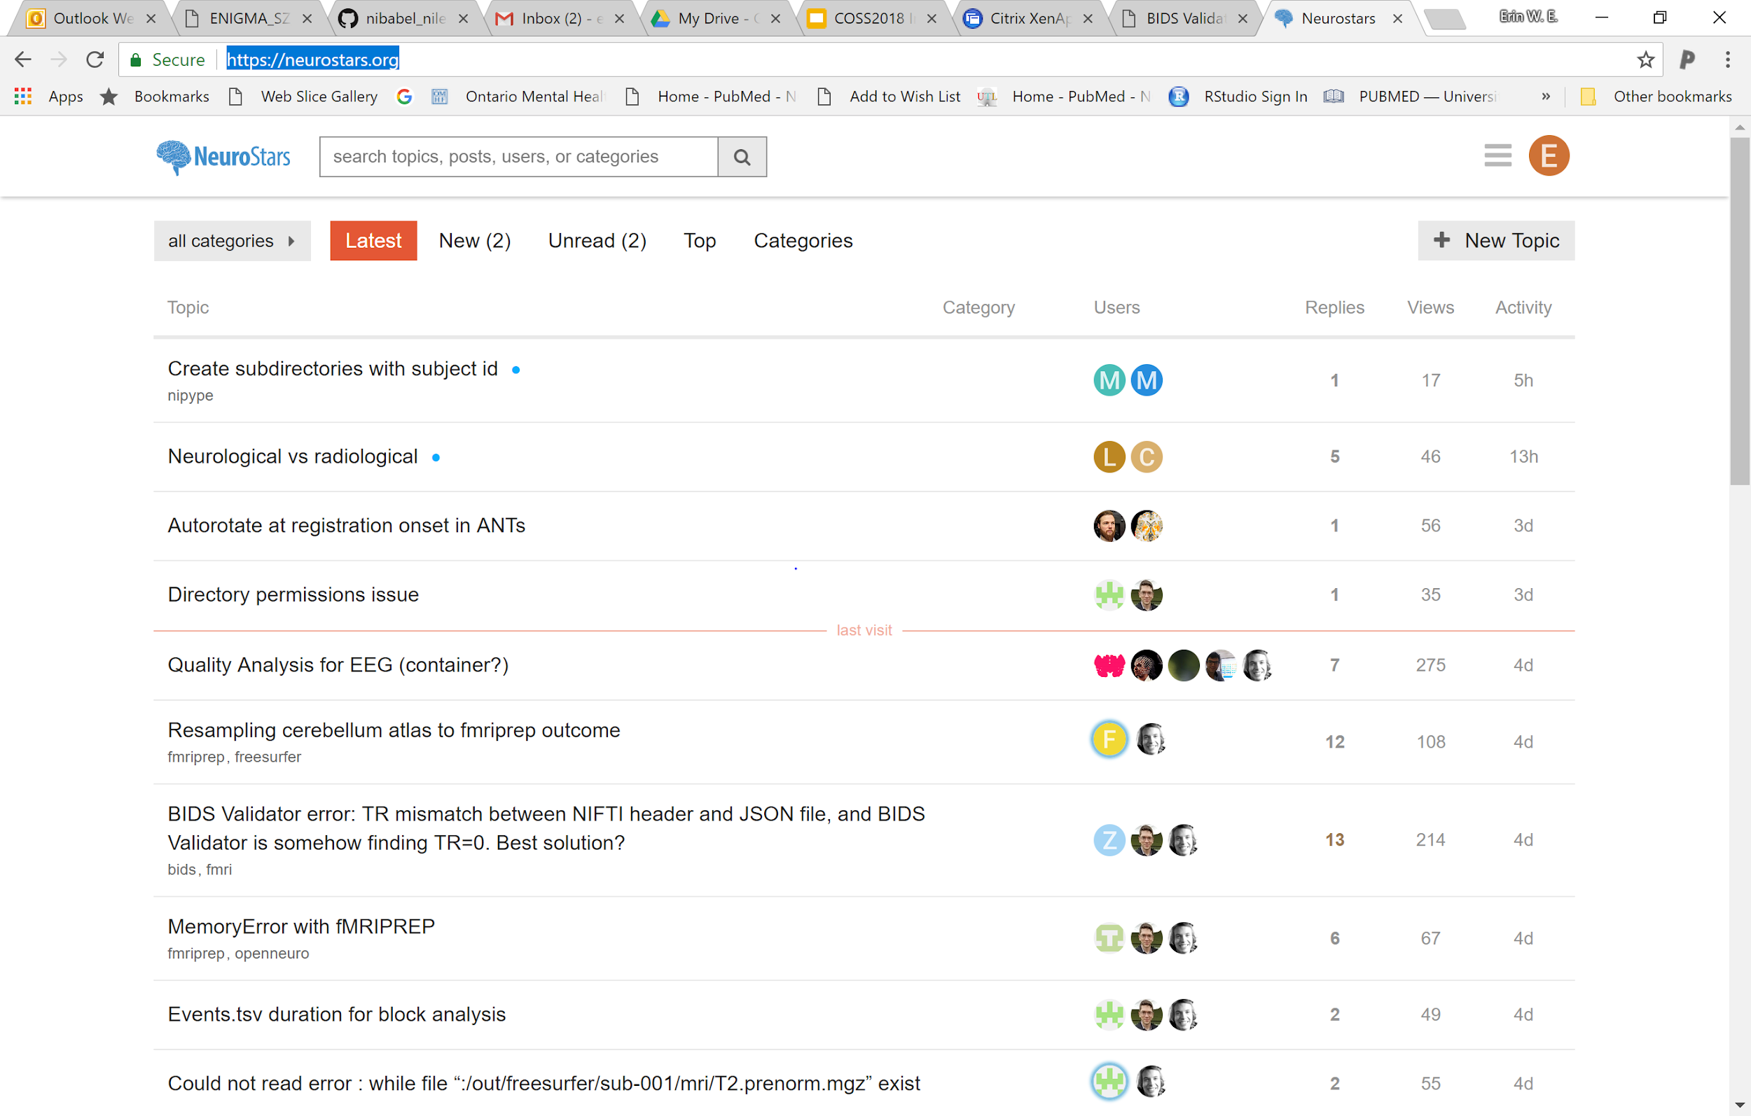
Neurostars.org
the friendliest neuroimaging support out there!

Slide 25
BIDS Apps - Why?
Reproducible workflows with a simpler - standard interface
Point and click with open neuro
Containers - easier install, easier implementation on clusters or clouds (AWS)
Runs on any machine (windows, mac, Linux)
More straight forward reporting (one version number says it all)
If you organise your data ... the pipeline will run.

Slide 26
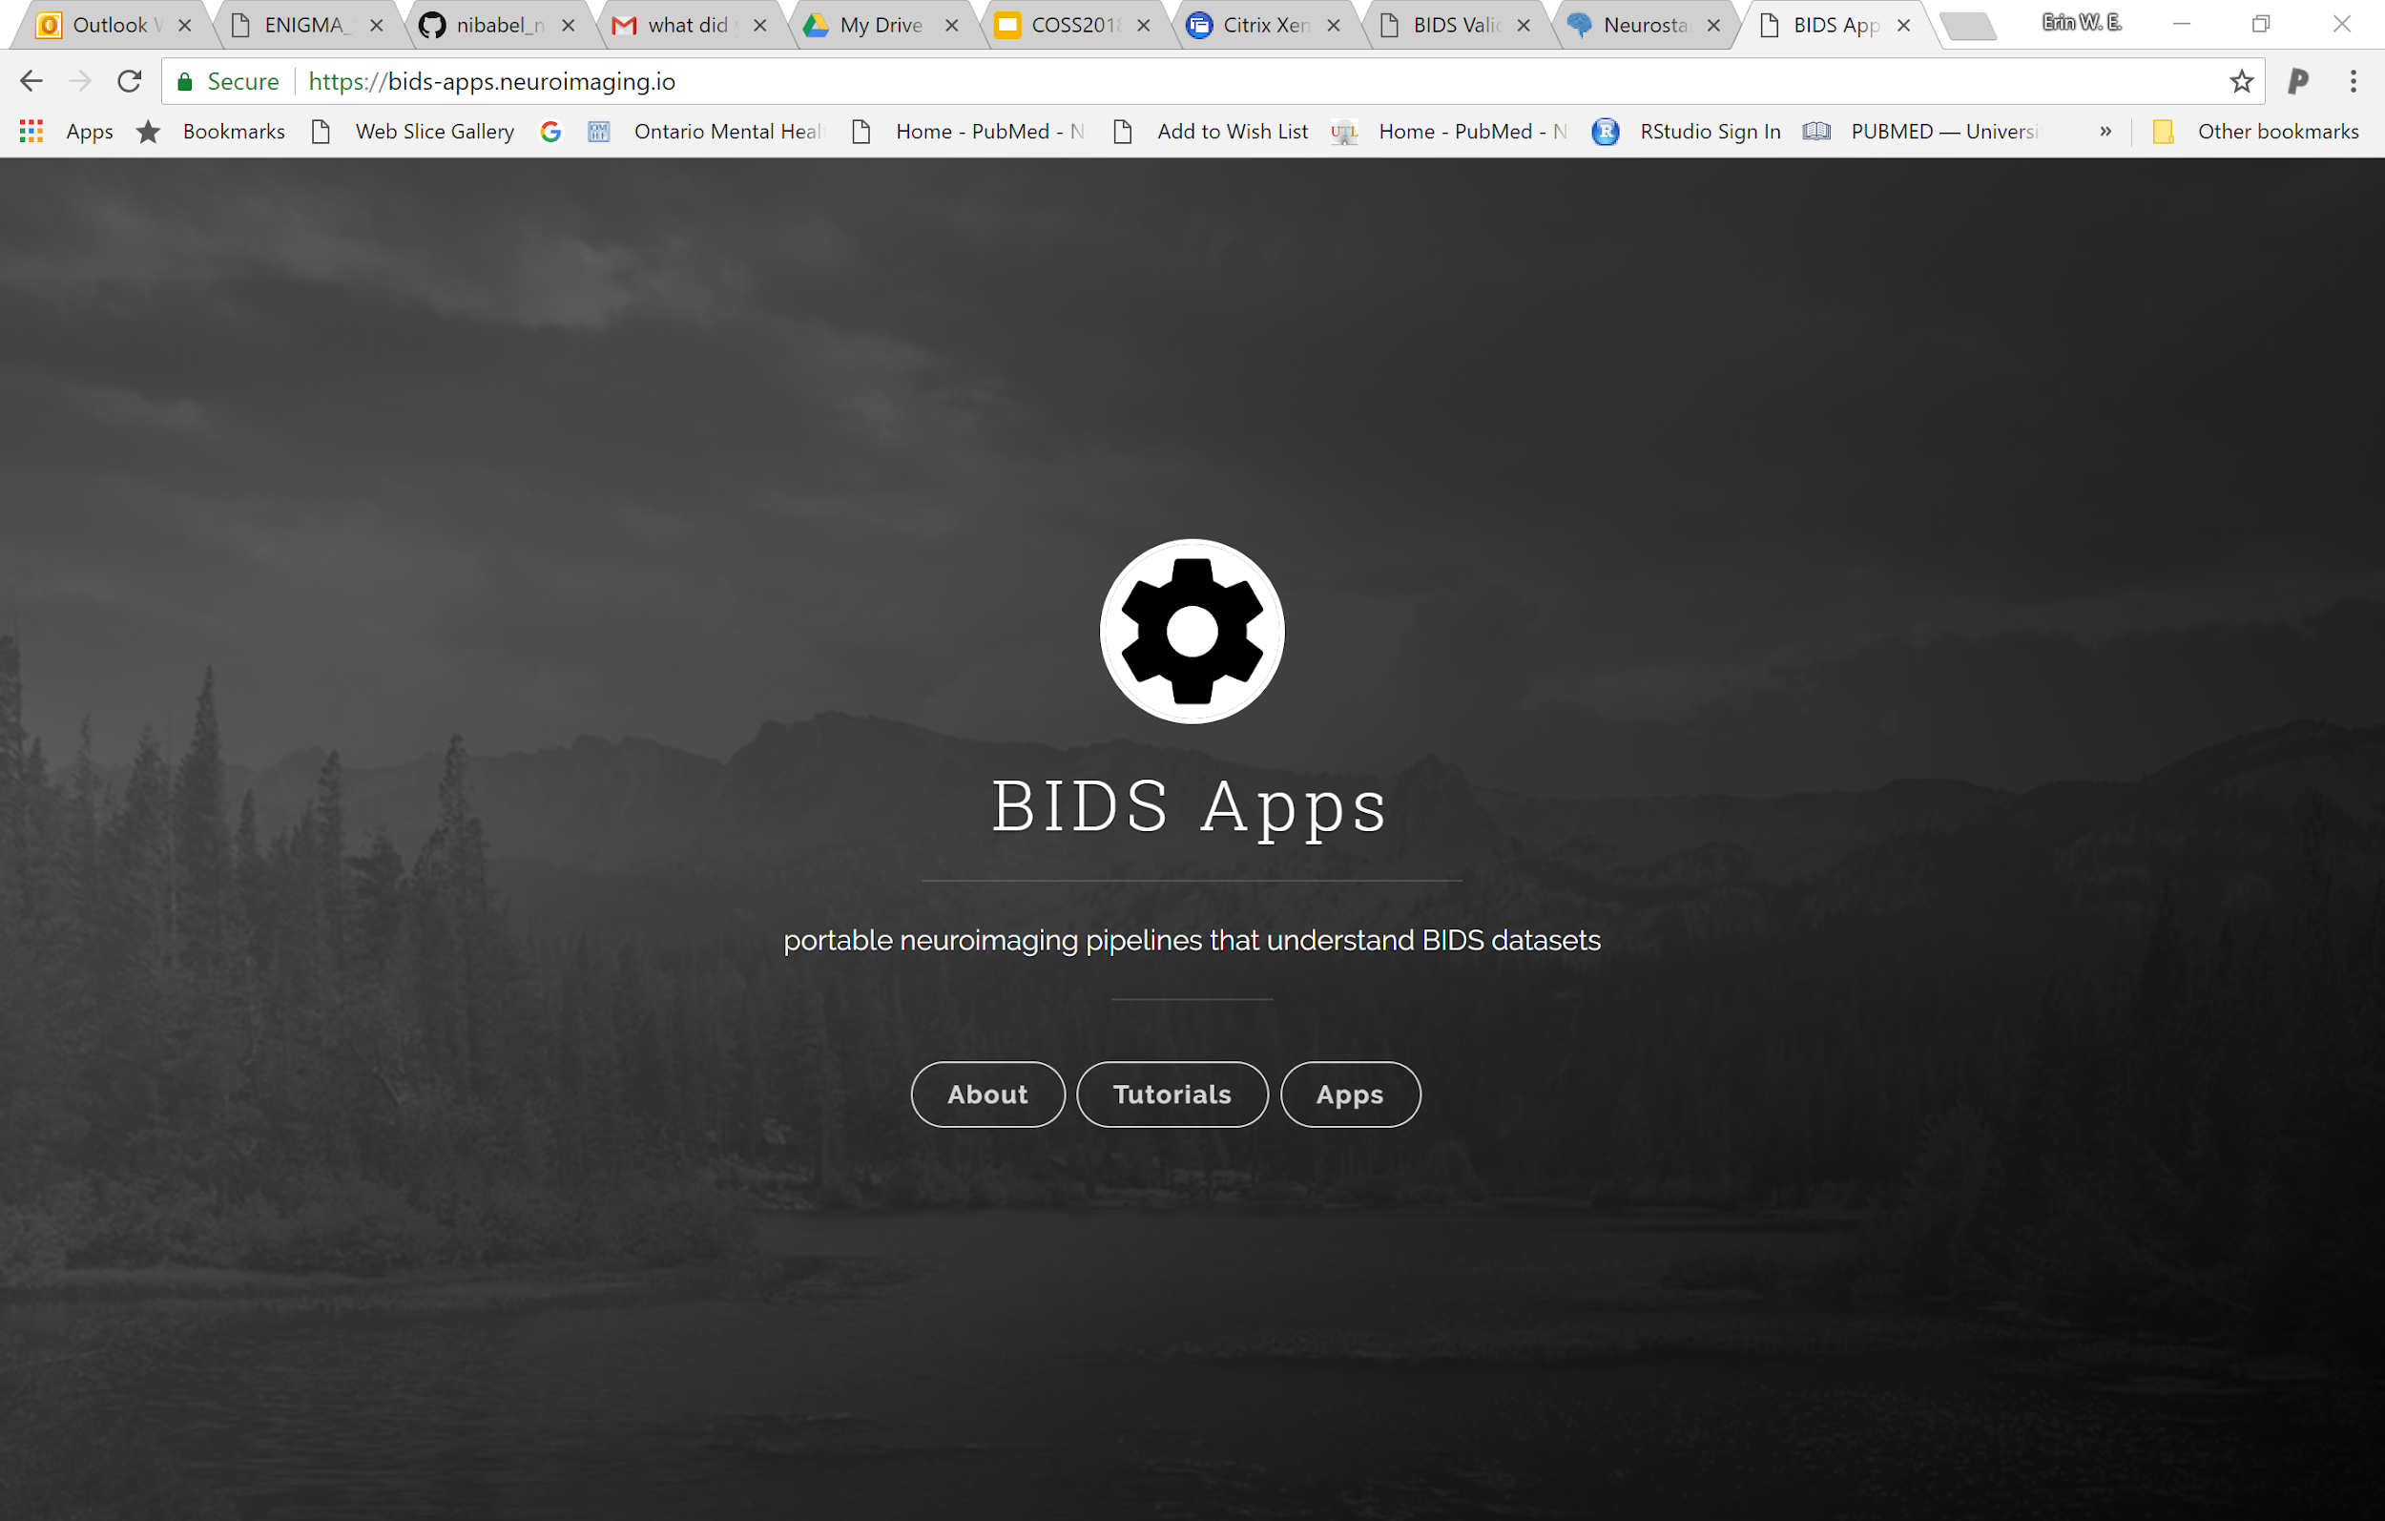
BIDS Apps - What?
https://bids-apps.neuroimaging.io/

Slide 27
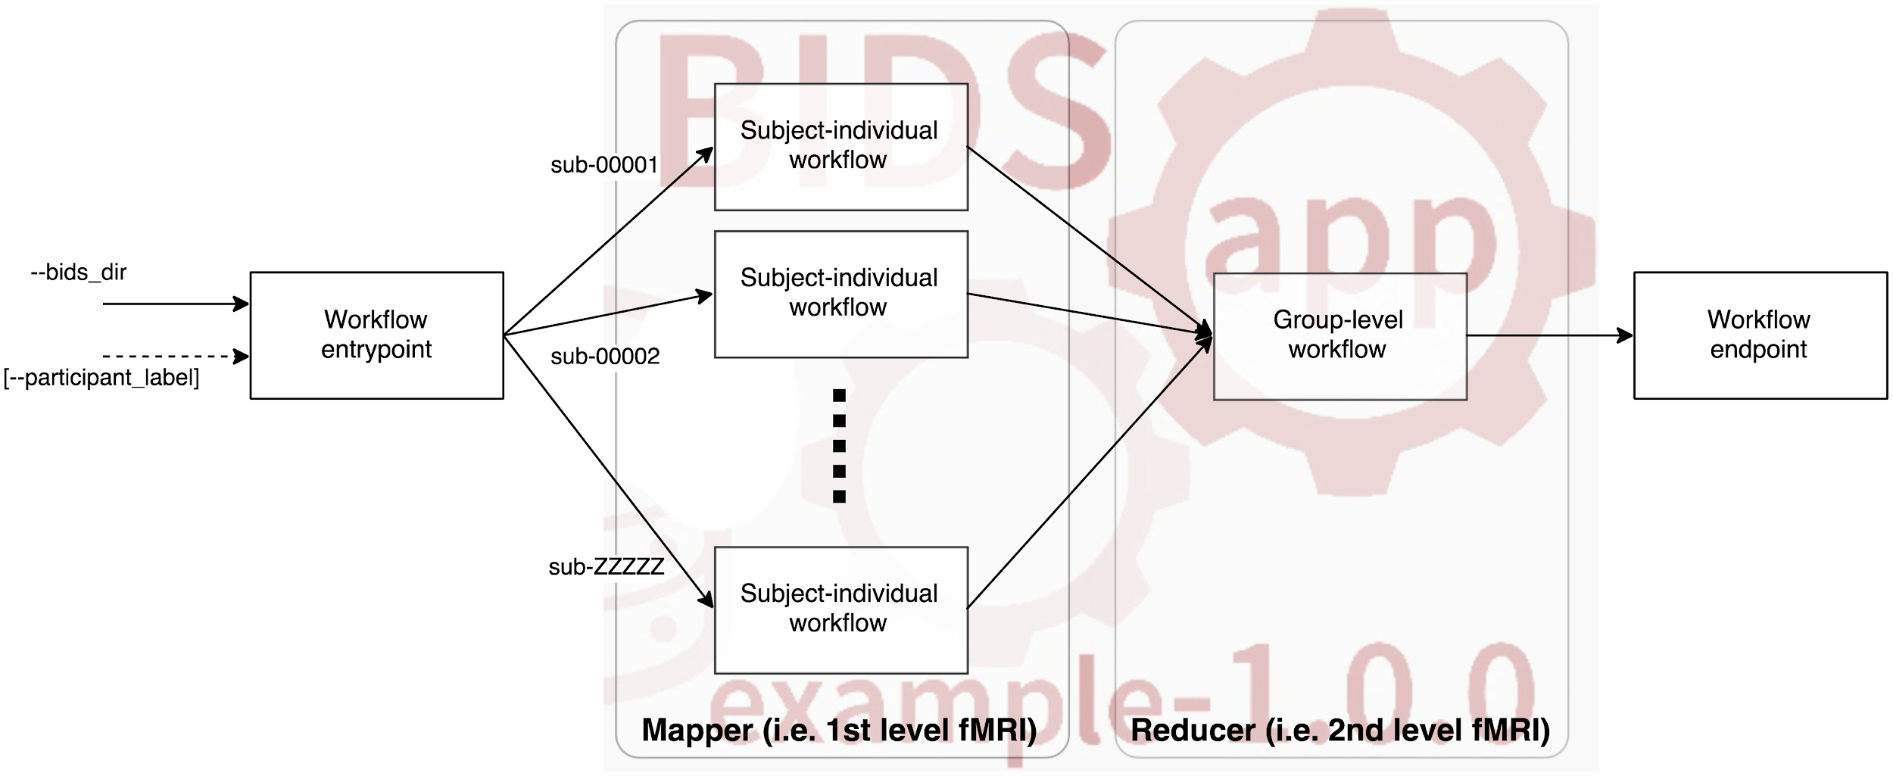
Common command line interface for users/computers
<runscript> <input_dataset> <output_folder> <analysis_level>
Notes:
Gorgolewski KJ, Alfaro-Almagro F, Auer T, Bellec P, Capotă M, Chakravarty MM, et al. BIDS apps: Improving ease of use, accessibility, and reproducibility of neuroimaging data analysis methods. PLoS Comput Biol. 2017;13: e1005209.

Slide 28
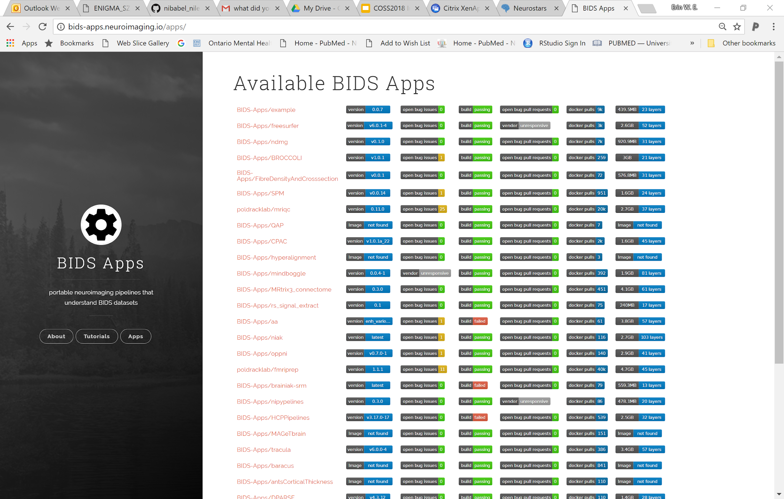
BIDS Apps
Mriqc
Fmriprep
Freesurfer
HCPipelines
MAGET

Slide 29
My fav BIDS apps
- fmriprep
- mriqc
- (ciftify)
- freesurfer
- HCPPipeline
- CPAC (the nice one...)

Slide 30
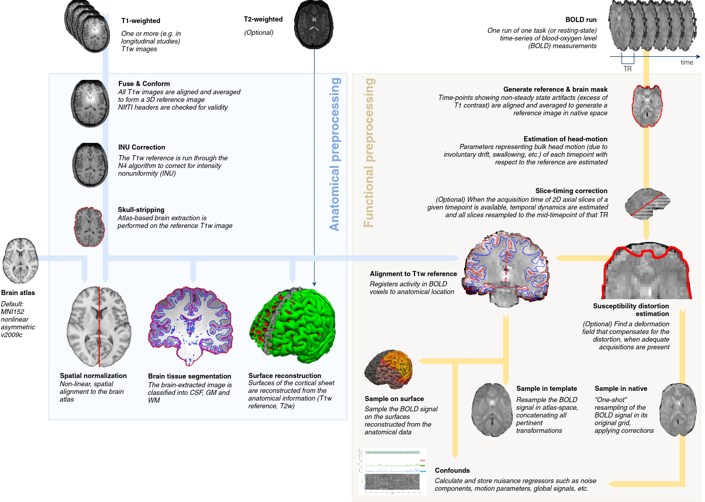
fmriprep: A Robust Preprocessing Pipeline for fMRI Data
Notes:
Esteban O, Markiewicz CJ, Blair RW, Moodie CA, Isik AI, Erramuzpe A, et al. fMRIPrep: a robust preprocessing pipeline for functional MRI. Nat Methods. 2019;16: 111–116.

Slide 31
MRIQC
Produces Quality Assurance Metrics for your T1w and Functional (fMRI) imaging data
And a very pretty visual report
Let’s grab one from openneuro to look at..
docker run -it --rm -v <bids_dir>:/data:ro -v <output_dir>:/out poldracklab/mriqc:latest /data /out participant --participant_label 001 002 003
docker run -it --rm -v <bids_dir>:/data:ro -v <output_dir>:/out poldracklab/mriqc:latest /data /out group

Slide 32

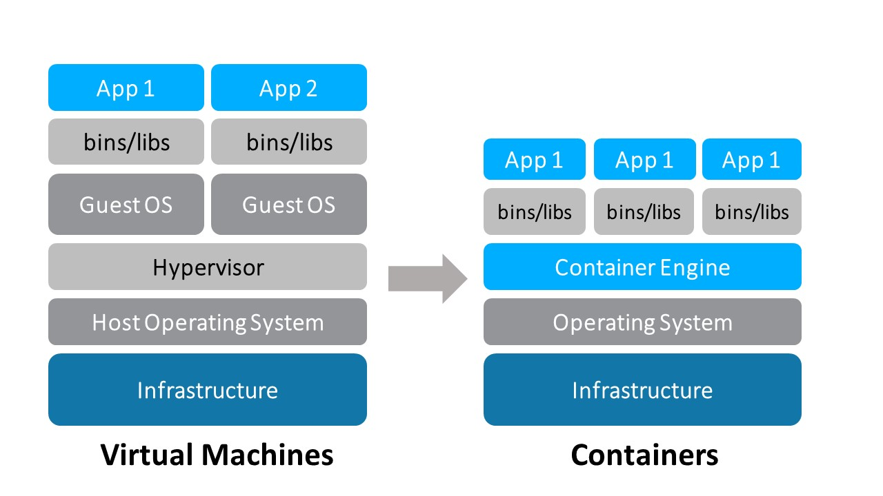

What’s a container?

Slide 33
Docker vs Singularity
 | Pro | Cons
Docker | Strong and building dev community can be pushed and pulled to dockerhub Works on any system (Windows, Mac, Linux) “Layers” decrease the hard disk space | Needs “root” access
Singularity | Does not need “root” access. Can converted from Docker | Smaller dev community Singularity hub exists, but is less used Only works on Linux

Slide 34
Docker vs Singularity
take home...
- we write a Docker spec
- we run singularity containers on the HPC

Slide 35
Translating Docker Usage to Singularity
 | Docker | Singularity
Running | Docker run -it --rm | Singularity run
Mounting or binding a path | -v, --volume | -B, --bind
Attaching the “workdir” | -w, --workdir | -W
Port forwarding | -p, --publish | N/A
Removing the outside environment | N/A | -e, --cleanenv
Change the mount to $HOME | N/A | -H, --home

Slide 36
Building a singularity container
Direct from dockerhub to singularity
Code: https://github.com/edickie/bids-on-scinet/blob/master/tutorial_code/01_building_singularity_containers.md
ssh <username>@teach.scinet.utoronto.ca
module load singularity
# note - in this example I am adding the new container to my $SCRATCH folder
mkdir $SCRATCH/test_sing_img
# singularity build <output-image> docker://<dockerhubuser>/<dockername>:<version>
singularity build $SCRATCH/test_sing_img/neurodocker_0.5.0.simg docker://kaczmarj/neurodocker:0.5.0

Slide 37
Building a singularity container
Build first using docker locally, and then convert
Code: https://github.com/edickie/bids-on-scinet/blob/master/tutorial_code/01_building_singularity_containers.md
Step1: build on another machine where you have root access - This can be your personal laptop
Notes:
I am running on a linux workstation where I have "sudo" access
If you use "docker run" on a container that dosen't exist on your system, Docker will build it for you first.
sudo docker run -it kaczmarj/neurodocker:0.5.0 --help

Slide 38
Building a singularity container
Build first using docker locally, and then convert
Code: https://github.com/edickie/bids-on-scinet/blob/master/tutorial_code/01_building_singularity_containers.md
Step 2: convert from docker to singularity - this uses a Docker image put out by singularity can docker2singularity
Note: we are using the "-v" mounts to give it two input paths
/var/run/docker.sock is the place where all your docker images are sitting
/scratch/edickie is the location where I want the output image to end up
sudo docker run --privileged -t --rm \
-v /var/run/docker.sock:/var/run/docker.sock \
-v /scratch/edickie/:/output \
singularityware/docker2singularity \
kaczmarj/neurodocker:0.5.0

Slide 39
A note about “latest”
Code: https://github.com/edickie/bids-on-scinet/blob/master/tutorial_code/01_building_singularity_containers.md
Most dockers will allow you to download the latest version of their software by typing “latest” instead of a version number
Problem - for reporting and debugging...you need the version number
So - for a real analysis - make sure to build a specific version and put the version number in the filename of the singularity image.

Slide 40
Running containers

Slide 41
Anatomy of a “run” command
Code: https://github.com/edickie/bids-on-scinet/blob/master/tutorial_code/02_running_singularity_containers.md
singularity run <singularity-image> <arguments>
ciftify_image=/scinet/course/ss2019/3/5_neuroimaging/containters/tigrlab_fmriprep_ciftify_1.3.0.post2-2.3.1-2019-04-04-8ebe3500bebf.img
singularity run ${ciftify_image} --help

Slide 42
On HPC’s use --cleanenv
Code: https://github.com/edickie/bids-on-scinet/blob/master/tutorial_code/02_running_singularity_containers.md
ciftify_image=/scinet/course/ss2019/3/5_neuroimaging/containters/tigrlab_fmriprep_ciftify_1.3.0.post2-2.3.1-2019-04-04-8ebe3500bebf.img
singularity run --cleanenv ${ciftify_image} --help

Slide 43
Now adding some data - Binding
Code: https://github.com/edickie/bids-on-scinet/blob/master/tutorial_code/02_running_singularity_containers.md
We think of our singularity image as a virtual machine, so we need to tell the "bind" our input and output folders to the image..
a "bind" within a command has three parts:
-B <path/outside/container>:</path/inside/container>
Example: -B $SCRATCH/datalad/ds000003:/bids-input

Slide 44
Binding a license
Code: https://github.com/edickie/bids-on-scinet/blob/master/tutorial_code/02_running_singularity_containers.md
ciftify_image=/scinet/course/ss2019/3/5_neuroimaging/containters/tigrlab_fmriprep_ciftify_1.3.0.post2-2.3.1-2019-04-04-8ebe3500bebf.img
mkdir -p $SCRATCH/ds000030/fmriprep-out
singularity run \
--cleanenv \
-B $SCRATCH/datalad/ds000030:/bids-input \
-B $SCRATCH/ds000030/fmriprep-out/:/output-folder \
${ciftify_image} \
/bids-input /output-folder participant \
--participant_label=10171 \
--anat_only --debug --dry-run
Bind the input and output data

Slide 45
Binding a license
Code: https://github.com/edickie/bids-on-scinet/blob/master/tutorial_code/02_running_singularity_containers.md
ciftify_image=/scinet/course/ss2019/3/5_neuroimaging/containters/tigrlab_fmriprep_ciftify_1.3.0.post2-2.3.1-2019-04-04-8ebe3500bebf.img
fs_license=/scinet/course/ss2019/3/5_neuroimaging/fs_license/license.txt
mkdir -p $SCRATCH/ds000030/fmriprep-out
singularity run \
--cleanenv \
-B $SCRATCH/datalad/ds000030:/bids-input \
-B $SCRATCH/ds000030/fmriprep-out/:/output-folder \
-B ${fs_license}:/freesurfer_license.txt \
${ciftify_image} \
/bids-input output-folder/ participant \
--participant_label=10171 \
--fs-license /freesurfer_license.txt \
--anat_only --debug --dry-run
Bind the freesurfer license

Slide 46
Binding a license
Code: https://github.com/edickie/bids-on-scinet/blob/master/tutorial_code/02_running_singularity_containers.md
ciftify_image=/scinet/course/ss2019/3/5_neuroimaging/containters/tigrlab_fmriprep_ciftify_1.3.0.post2-2.3.1-2019-04-04-8ebe3500bebf.img
fs_license=/scinet/course/ss2019/3/5_neuroimaging/fs_license/license.txt
mkdir -p $SCRATCH/ds000030/fmriprep-out
mkdir $SCRATCH/sing_home
singularity run \
--cleanenv \
-H $SCRATCH/sing_home \
-B $SCRATCH/datalad/ds000030:/bids-input \
-B $SCRATCH/ds000030/fmriprep-out/:/output-folder \
-B ${fs_license}:/freesurfer_license.txt \
${ciftify_image} \
/bids-input output-folder/ participant \
--participant_label=10171 \
--fs-license /freesurfer_license.txt \
--anat_only --debug --dry-run
reset the $HOME

Slide 47
Binding a license
Code: https://github.com/edickie/bids-on-scinet/blob/master/tutorial_code/02_running_singularity_containers.md
ciftify_image=/scinet/course/ss2019/3/5_neuroimaging/containters/tigrlab_fmriprep_ciftify_1.3.0.post2-2.3.1-2019-04-04-8ebe3500bebf.img
fs_license=/scinet/course/ss2019/3/5_neuroimaging/fs_license/license.txt
mkdir -p $SCRATCH/ds000030/fmriprep-out
mkdir $SCRATCH/sing_home
singularity run \
--cleanenv \
-H $SCRATCH/sing_home \
-B $SCRATCH/datalad/ds000030:/bids-input \
-B $SCRATCH/ds000030/fmriprep-out/:/output-folder \
-B ${fs_license}:/freesurfer_license.txt \
-B ${BBUFFER}:/bbuffer \
${ciftify_image} \
/bids-input output-folder/ participant \
--participant_label=10171 \
--fs-license /freesurfer_license.txt \
--fmriprep-workdir /bbuffer \
--anat_only --debug --dry-run
Bind the $BBUFFER to the workdir

Slide 48
Binding a license
Code: https://github.com/edickie/bids-on-scinet/blob/master/examples/02_running_singularity_containers.md
ciftify_image=/scinet/course/ss2019/3/5_neuroimaging/containters/tigrlab_fmriprep_ciftify_1.3.0.post2-2.3.1-2019-04-04-8ebe3500bebf.img
fs_license=/scinet/course/ss2019/3/5_neuroimaging/fs_license/license.txt
mkdir -p $SCRATCH/ds000030/fmriprep-out
mkdir $SCRATCH/sing_home
singularity run \
--cleanenv \
-H $SCRATCH/sing_home \
-B $SCRATCH/datalad/ds000030:/bids-input \
-B $SCRATCH/ds000030/fmriprep-out/:/output-folder \
-B ${fs_license}:/freesurfer_license.txt \
-B ${BBUFFER}:/bbuffer \
${ciftify_image} \
/bids-input output-folder/ participant \
--participant_label=10171 \
--fs-license /freesurfer_license.txt \
--fmriprep-workdir /bbuffer \
--n_cpus 8 \
--anat_only --debug --dry-run
Specify the number of cpus

Slide 49
singularity shell and exec

Slide 50
Using singularity “shell” to create and interactive env
Code: https://github.com/edickie/bids-on-scinet/blob/master/tutorial_code/03_singularity_shell_and_exec.md
fmriprep_image=/scinet/course/ss2019/3/5_neuroimaging/containters/poldracklab_fmriprep_1.3.2-2019-03-18-573e99cc5d39.simg
singularity shell --cleanenv -B $SCRATCH:/scratch ${fmriprep_image}

Slide 51
Using singularity “exec” to build custom scripts from a container env.
Code: https://github.com/edickie/bids-on-scinet/blob/master/tutorial_code/03_singularity_shell_and_exec.md
singularity exec <singularity-options> <singularity-image> <command-line-argument>
fmriprep_image=/scinet/course/ss2019/3/5_neuroimaging/containters/poldracklab_fmriprep_1.3.2-2019-03-18-573e99cc5d39.simg
singularity exec --cleanenv -B $SCRATCH:/scratch \
${fmriprep_image} fslmaths \ /scratch/datalad/ds000030/sub-10171/func/sub-10171_task-rest_bold.nii.gz \
-Tmean /scratch/test_tmean_exec.nii.gz

Slide 52
Running many containers at once on an HPC

Slide 53
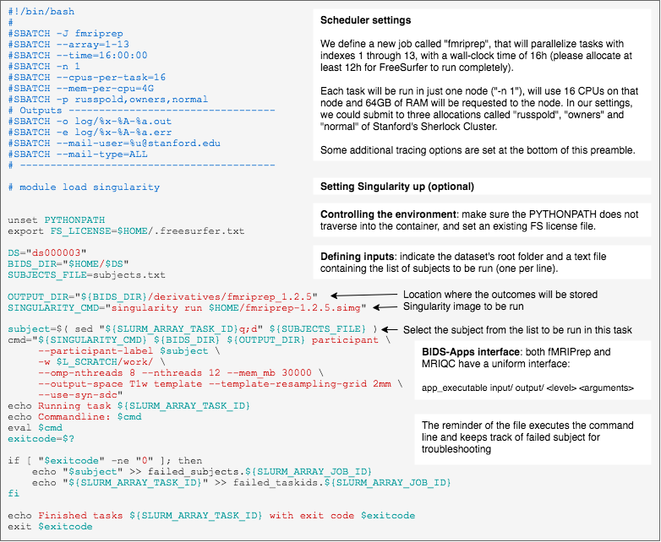
Running many containers at once on an HPC
Thanks to Oscar Esteban!

Slide 54
What about building a new container?

Slide 55
Building your own Docker container - using Neurodocker
Neurodocker
https://github.com/kaczmarj/neurodocker
https://github.com/kaczmarj/neurodocker/tree/master/examples
Notes:
Demoing neurodocker:

Slide 56
For example - building an FSL env with Neurodocker..
neurodocker generate [docker|singularity] \
--base=debian:stretch --pkg-manager=apt \
--fsl version=5.0.10 method=binaries

Slide 57
Please fill out the survey!
https://bit.ly/2N9PF6s

